Slide 1
C++ Classes
Nilanjana G. Basu, HIT, Kolkata

Slide 2
Program
#include<iostream>
using namespace std;
class student{
private:
string name;
string roll;
int age;
public:
void display(){// definition inside class and considered inline by default
cout<< "Name: "<<name <<endl << "Roll: "<<roll <<endl <<"Age: "<< age << endl;
}
void input(); //definition outside class
};

Slide 3
Program 1
void student::input(){ //inline should be mentioned if inlining is needed
cout<< "Enter Input" <<endl;
getline(cin, name);
getline(cin, roll);
cin>> age;
cin.ignore();
}
int main(){student s[5];
for(int i=0;i<5;i++)
{
s[i].input();
s[i].display();
}
return 0;}

Slide 4
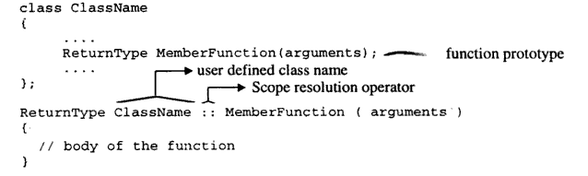
Function Definition outside class

Slide 5
Passing object to functions
#include<iostream>
using namespace std;
class A{
public:
int a,b;
void add(A ob){
ob.a+=a;
ob.b+=b;
//a+=ob.a;b+=ob.b;
}
void add_ref(A & ob){
ob.a+=a;
ob.b+=b;
}
void add( A * ob){
ob->a+=a;
ob->b+=b;
}
void show(){
cout<<a<<endl<<b<<endl;
}
};

Slide 6
continued
int main(){
A one;
one.a=10;one.b=20;
A two;
two.a=10;two.b=20;
cout<<"Call by value"<<endl;
one.add(two);
cout<<"showing one"<<endl;
one.show();
cout<<"showing two"<<endl;
two.show();
cout<<"Call by reference"<<endl;
one.add_ref(two);
cout<<"showing one"<<endl;
one.show();
cout<<"showing two"<<endl;
two.show();
cout<<"Call by address"<<endl;
one.add(&two);
cout<<"showing one"<<endl;
one.show();
cout<<"showing two"<<endl;
two.show(); return 0;
}

Slide 7
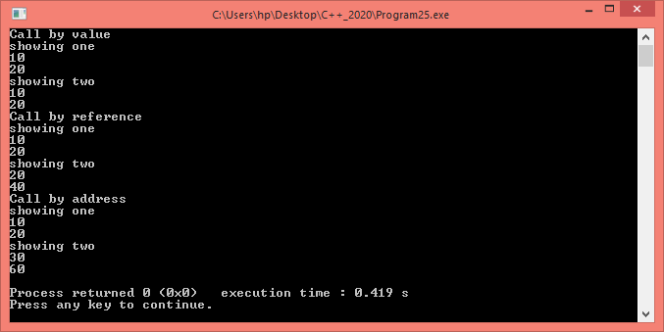
Output

Slide 8
Returning object
class A{
public:
int a,b;
A add(A ob){
A result;
result.a=a+ob.a;
result.b=b+ob.b;
return result;
}
void show(){
cout<<a<<endl<<b<<endl;
}
};
int main(){
A one;
one.a=10;one.b=20;
A two;
two.a=10;two.b=20;
A three=one.add(two);
three.show();
return 0;
}

Slide 9
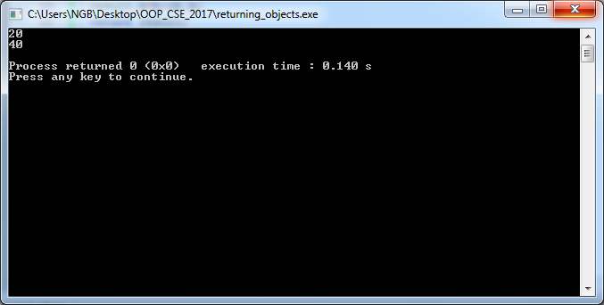
Output

Slide 10
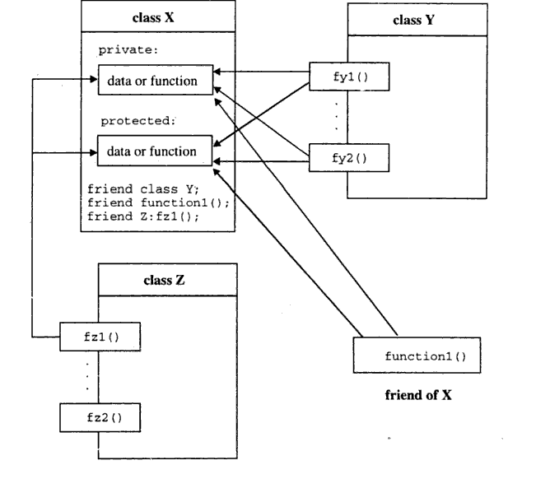
Friend function and class

Slide 11
Characteristics of friend functions
The scope of a friend function is not limited to the class in which it has been declared as a friend
A friend function cannot be called using the object of that class. It can be called like an independent function
It cannot access class members directly. It can use the object and the dot operator
It can be either declared in the private or protected part of a class without affecting its meaning

Slide 12
Program 2
#include<iostream>
using namespace std;
class faculty_ece;
class faculty_cse{
int faclty_id;
friend void hod(faculty_cse obj){cout<<"inside hod function "<<obj.faclty_id<<endl;}
friend void swap(faculty_cse &, faculty_ece &);
public:
string dep;
void setdata(int a, string d){faclty_id=a;dep=d;}
void showdata(){cout<<"inside faculty_cse "<<faclty_id<<" "<<dep<<endl;}
friend class A;
};

Slide 13
Contd..
class faculty_ece{
int faclty_id;
public:
string dep;
void setdata(int a, string d){faclty_id=a;dep=d;}
void showdata(){cout<<"inside faculty_ece "<<faclty_id<<" "<<dep<<endl;}
friend void swap(faculty_cse &, faculty_ece &);
};
void swap(faculty_cse & ob1, faculty_ece & ob2){int temp;
temp=ob1.faclty_id;
ob1.faclty_id=ob2.faclty_id;
ob2.faclty_id=temp;
}

Slide 14
Contd..
class A{
public:
void showdata(){ faculty_cse ob1;ob1.setdata(1,"IT"); cout<<"Inside A "<<ob1.faclty_id<<" "<<ob1.dep<<endl;}
};
int main(){
faculty_cse f1;
f1.setdata(123, "n/w");
f1.showdata();
faculty_ece f2;
f2.setdata(456,"communication");
f2.showdata();
hod(f1);
swap(f1,f2);
f1.showdata();
f2.showdata();
A obj;
obj.showdata();
return 0;
}

Slide 15
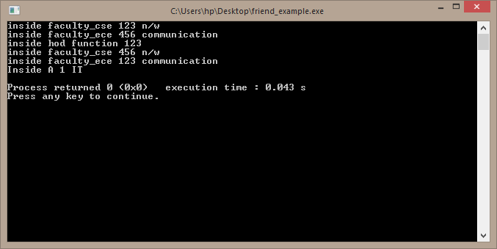
Output

Slide 16
Points to be remembered about friend function
Friendship is not transitive
Friendship is not symmetric
Friendship is not inherited
Friendship should be used only where it is absolutely necessary as otherwise it creates exceptions to the rule of data hiding
Connecting two different classes as a bridge, is the ideal scenario to use friend function

Slide 17
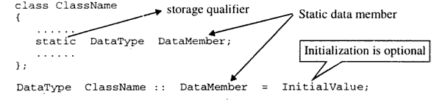
Static member

Slide 18
Program 1
#include<iostream>
using namespace std;
class faculty_cse{
public:
//static string dep="CSE";
static string dep;
string name;
static void show(){
//cout<<name<<endl;
cout<<dep<<endl;}
};
string faculty_cse::dep="CSE";

Slide 19
Contd..
int main(){
faculty_cse f1;
f1.name="Nilanjana";
f1.show();
f1.dep="IT";
f1.show();
cout<<faculty_cse::dep<<endl;
return 0;
}

Slide 20
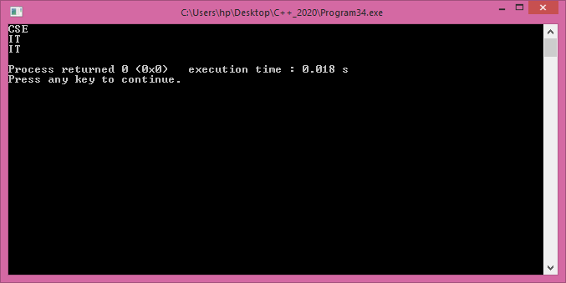
Output

Slide 21
Points to remember
Persistence: it remains in memory until the end of the program.
File scope: it can be seen only within a file where it's defined.
Visibility: if it is defined within a function/block, it's scope is limited to the function/block. It cannot be accessed outside of the function/block.
Class: static members exist as members of the class rather than as an instance in each object of the class. So, this keyword is not available in a static member function. Such functions may access only static data members. There is only a single instance of each static data member for the entire class: A static data member : class variable A non-static data member : instance variable
Static member function: it can only access static member data, or other static member functions while non-static member functions can access all data members of the class: static and non-static.

Slide 22
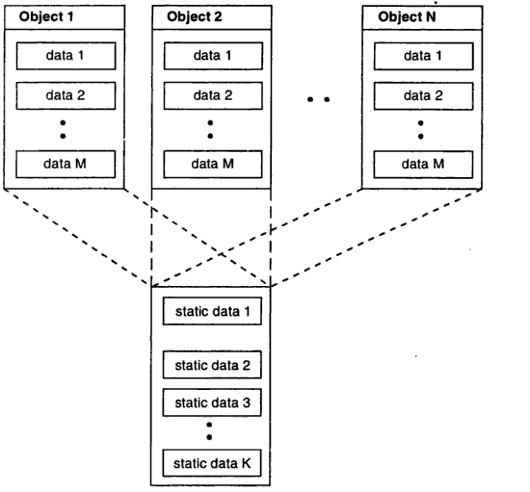
Memory for static data

Slide 23
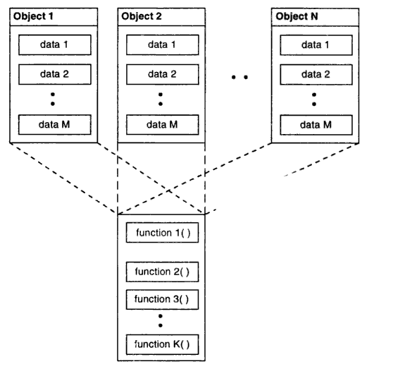
Memory for functions

Slide 24
Program 2
#include<iostream>
using namespace std;
class student{
private:
string name;//instance variables
string roll;
int marks[3];
public:
int total=0;
string getName(){return name;}

Slide 25
Contd..
void display(){
cout<<endl << "Name: "<<name <<endl << "Roll: "<<roll <<endl;
for(int i=0;i<3;i++)
{
cout<<"marks of subject["<<i+1<<"] "<<marks[i]<<endl;
}
cout<<"Total marks"<<total<<endl<<endl;
}
void input();
static int topper(student *);
};

Slide 26
Contd..
void student::input(){
cout<< "Enter Input" <<endl;
cout<< "Enter Name" <<endl;
getline(cin, name);
cout<< "Enter Roll" <<endl;
getline(cin, roll);
for(int i=0;i<3;i++)
{
cout<<"Enter marks of subject["<<i+1<<"]"<<endl;
cin>>marks[i];
total+=marks[i];
}
cin.ignore();
}

Slide 27
Contd..
int student::topper(student *obj){
int t=0;
for(int i=1;i<3;i++)
if(obj[i].total>obj[t].total)
t=i;
return t;
}

Slide 28
Contd..
int main(){
student s[3];
for(int i=0;i<3;i++)
{
s[i].input();//s[i] is an instance of the class student
s[i].display();
}
cout<<"Topper is "<<s[student::topper(s)].getName()<<", with marks "<<s[student::topper(s)].total;
return 0;
}

Slide 29
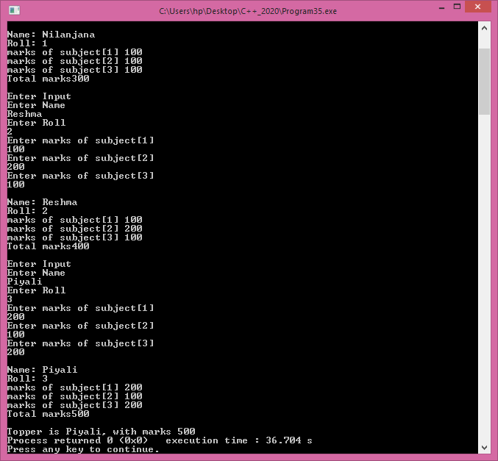
output

Slide 30
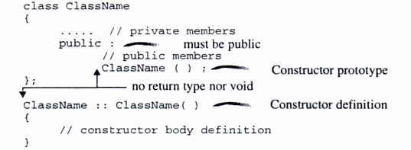
Constructor

Slide 31
Program 1
class test{
int num; string name;
public:
test(int a) : num(a){}
test(){ num=0;}
test(int a, string b);
};
test::test(int a, string b):num(a),name(b){}
int main(){
test one;
test two(12);
test three(100, “ABC”);
return 0;
}

Slide 32
Initializer list vs initializing inside body
Using the initializer list, the members are created and initialized only once, with the given value.
Using assignment, the members are initialized with a default value, then reassigned in the constructor body.
In some cases (constants, references) you can only use initialization lists because these must be initialized with a valid value, and once they are constructed, reassigning them is illegal.
In other cases, even though assignment is possible, initialization list is still preferable as it avoids extra work (double initialization, which can be costly for some types) and adheres to a common idiom, making your code easier to understand and maintain.

Slide 33
Initializer list
The order of initialization of members is defined by their order of declaration, not by the order in which they are listed in the initialization list
class Example { int a, b, c;
public:
Example() : a(1), c(2), b(4) {} }

Slide 34
Program 1
#include<iostream>
using namespace std;
class B{
private: int a,b,c;
public:
B(int x, int y):a(x),b(y),c(2*b){}
//B(int x, int y):a(x),c(y),b(c){}
void show(){cout<<a<<" "<<b<<" "<<c<<endl;}
};
int main(){
B obj(10,20);
obj.show();
}

Slide 35
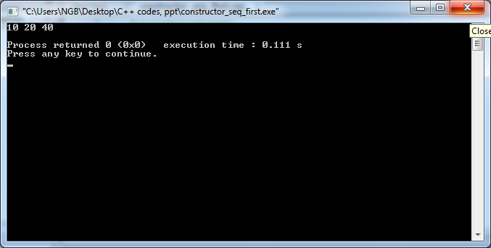
output

Slide 36
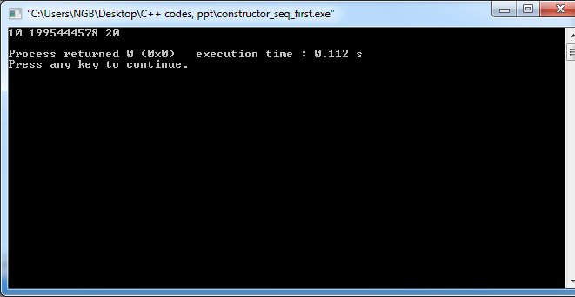
Erroneous output

Slide 37
Defining scope in switch case
#include<iostream>
#include<cstdlib>
using namespace std;
class B{
private: int a,b,c;
public:
B(int x, int y):a(x),b(y),c(2*b){}
void show(){cout<<a<<" "<<b<<" "<<c<<endl;}
};
int main(){
int i;
cin>>i;
switch(i){
case 1: B obj(10,20); obj.show();
case 2: B obj2(20,30); obj2.show();
default: exit(0);
}
}

Slide 38
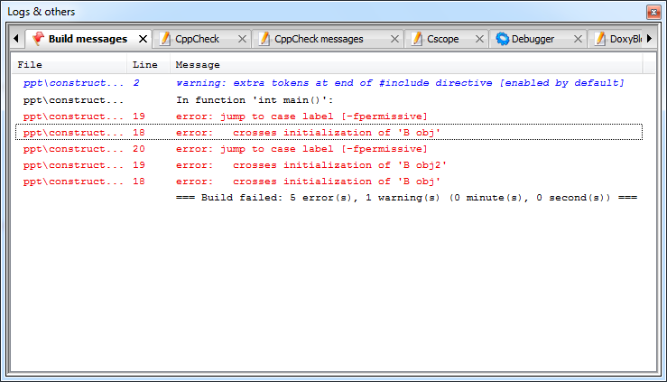
Erroneous msgs

Slide 39
Corrected Program
int main(){
int i;
cin>>i;
switch(i){
case 1: {B obj(10,20); obj.show();}
case 2: {B obj2(20,30); obj2.show();}
default: exit(0);
}
}

Slide 40
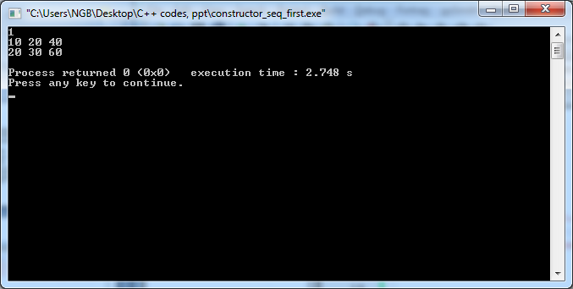
output

Slide 41
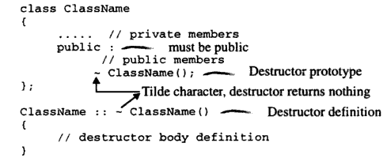
Destructor

Slide 42
Program 1
class test{
public:
test(){ cout<<"Cons"<<endl;}
~test(){cout<<"dest"<<endl;}
};
int main(){
cout<<"First"<<endl;
test one;
{ cout<<"Second"<<endl;
test two;
{
cout<<"Third"<<endl;
test three;
cout<<"Third"<<endl;
}
cout<<"Second"<<endl;
}
cout<<"First"<<endl;
return 0;
}

Slide 43
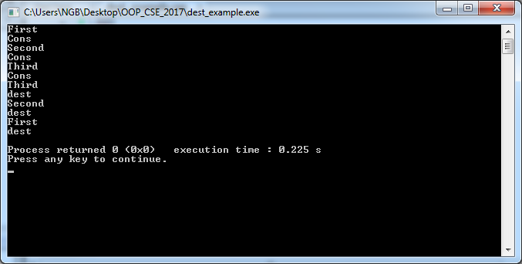
Output

Slide 44
Static Object
Static objects are initialized only once and stored in the static storage area.
These are only destroyed when the program terminates i.e. they live until program termination.

Slide 45
Program 1
#include<iostream>
using namespace std;
class A{string name;
public:
A(string n):name(n){cout<<"CONS "<<name<<endl;}
~A(){cout<<"DEST "<<name<<endl;}
};
void func(){static A obj("obj");cout<<"func exits"<<endl;}
static A obj3("obj3");
int main(){func();
{static A obj2("obj2");}
cout<<"main exits"<<endl;
return 0;}

Slide 46
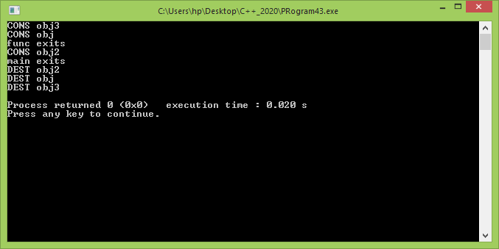
Output

Slide 47
Constant objects and constant member function
#include<iostream>
using namespace std;
class faculty_cse{
int faclty_id;
public:
string dep;
faculty_cse(int a, string d){faclty_id=a;dep=d;}
void showdata()const{
cout<<"inside faculty_cse "<<faclty_id<<" "<<dep<<endl;
//faclty_id=222;
}
void change_dept(string dep){this->dep=dep;}
};
int main(){
faculty_cse f1(123,"n/w");
f1.showdata();
f1.change_dept("ECE");
const faculty_cse f2(456,"n/w");
f2.showdata();
//f2.change_dept("AEIE");
return 0;
}

Slide 48
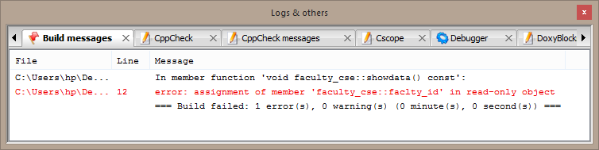
Erroneous msgs

Slide 49
Program 2
#include<iostream>
using namespace std;
class faculty_cse{
int faclty_id;
public:
string dep;
void setdata(int a, string d){faclty_id=a;dep=d;}
void showdata()const{
cout<<"inside faculty_cse "<<faclty_id<<" "<<dep<<endl;
}
void join_dep(faculty_cse const f){
//f.dep="BT"; //this line will give compiler error in next slide
dep=f.dep;faclty_id=f.faclty_id+10;}
};

Slide 50
Contd..
int main(){
faculty_cse f1;
f1.setdata(123, "n/w");
f1.showdata();
faculty_cse f2;
f2.join_dep(f1);
f2.showdata();
return 0;
}

Slide 51
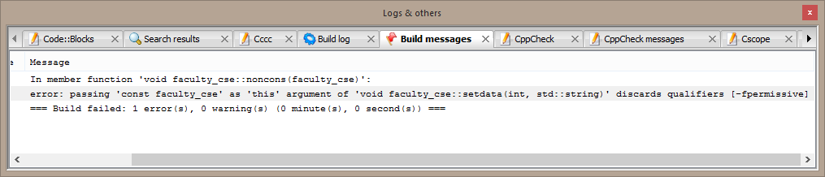
Error msgs

Slide 52
Counting alive objects
#include<iostream>
using namespace std;
class test{
static int obj_count;
static int obj_alive;
public:
test(){ obj_count++;obj_alive++;}
~test(){obj_alive--;}
void show(){cout<<obj_count<<" " << obj_alive<<endl;}
};
int test:: obj_count, test:: obj_alive=0;
int main(){
cout<<"Created"<<" "<<"Alive"<<endl;
test one;
one.show();
{
test two;
two.show();
{
test three;
three.show();
}
two.show();
}
one.show();
return 0;
}

Slide 53
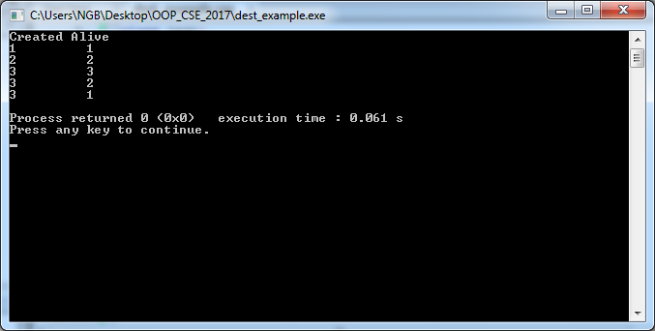
Output

Slide 54
Constructor vs Destructor
constructor name is same as the class name while name of the destructor is prefixed with a tilde(~) with class name
Destructors cannot be overloaded because destructor cannot take any argument and also there can be only one destructor in a class
Other than the above destructor can be virtual, constructors cannot be virtual
Destructor is called when the object goes out of scope and no longer needed

Slide 55
Global objects
#include<iostream>
#include<cstring>
using namespace std;
class test{
char *b;
public:
test(){ b=new char[10]; strcpy(b,"CSE_2020"); cout<<b<<" “ <<"noparam"<<endl;}
test(char * str){int len=strlen(str)+1; b=new char[len]; strcpy(b,str); cout<<b<<" "<<"param"<<endl;}
~test();
void show(){ }
};
test::~test(){ cout<<b<<" "<<"dest"<<endl;delete b; }
void func(){ cout<< "Function"<<endl;test obj;}

Slide 56
Contd…
int main(){
test one;
test two("HI");
func();
return 0;
}
test t; test t2("Global");

Slide 57
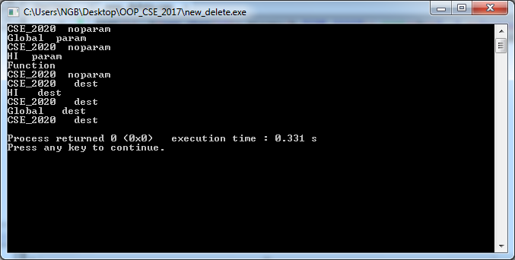
Output

Slide 58
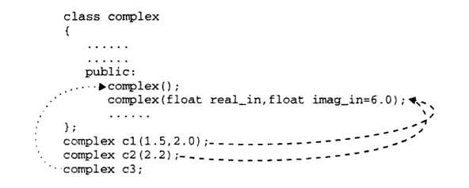
Constructor with default arguments

Slide 59
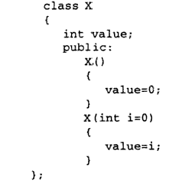
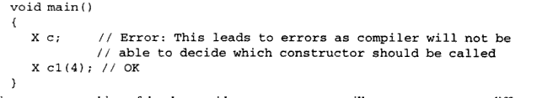
Erroneous code

Slide 60

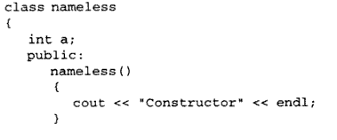
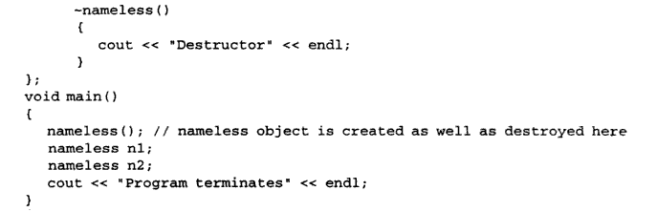
Nameless Objects

Slide 61
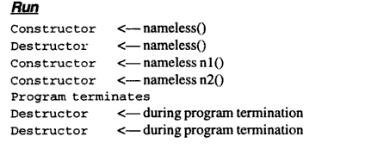
Output

Slide 62
Copy Constructor
Copy constructor may be called in the following cases:
When an object is passed as an argument by value to a function
When an object is returned by value from a function
When an object is constructed based on another object of the same class
When compiler generates a temporary object.
#include<iostream>
using namespace std;
class complex{
int *real,*imag;
public:
complex(){
real=new int; imag=new int;
*real=0; *imag=0;
}
complex(int a, int b){
real=new int; imag=new int;
*real=a; *imag=b;
}
complex(const complex & ob){
cout<<"copy"<<endl;
real=new int; imag=new int;
*real=*ob.real; *imag=*ob.imag;
}

Slide 63
Contd..
complex add(complex obj){complex c;
*c.real=*real+*obj.real;
*c.imag=*imag+*obj.imag;
cout<<*c.real<<" " <<*c.imag<<endl;
return c;
}
complex multiply(complex obj){complex c;
*c.real=*real+*obj.real;
*c.imag=*imag+*obj.imag;
cout<<*c.real<<" " <<*c.imag<<endl;
return c;
}
void show(){
cout<<*real<<" " <<*imag<<endl;
}
~complex(){cout<<"destructor"<<endl;delete real; delete imag;}
};
int main(){
complex a(1,2);
complex b(2,3);
complex result(a.add(b));
result.show();
complex result1=a.multiply(b);
result1.show();
return 0;
}

Slide 64
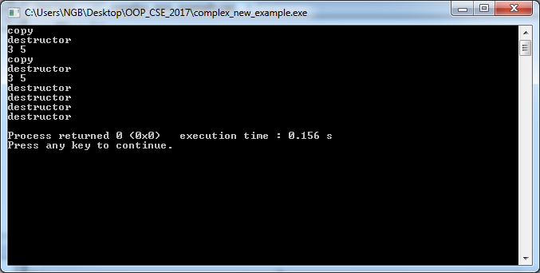
Output

Slide 65
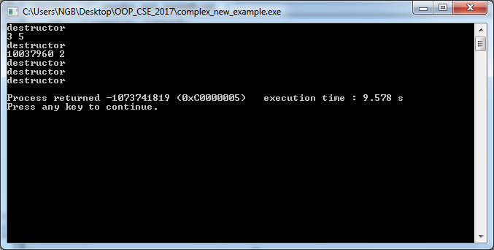
What if I do not write the Copy constructor?

Slide 66
With default copy constructor
In add function when we pass b as an argument to assign obj,
b.real 1000 (memory address) obj.real
b.imag 2000 (memory address) obj.imag
When add function ends, after destructor call
1000, 2000 memory location is being deallocated
So in the next call of multiply, object b is pointing to some memory location where garbage value is stored and so, object obj in multiply function is also not getting the intended value.

Slide 67
Point to remember
It is however, not guaranteed that a copy constructor will be called in all these cases, because the C++ Standard allows the compiler to optimize the copy away in certain cases, one example being the return value optimization (sometimes referred to as RVO).
Assignment: study about RVO in C++

Slide 68
Pointer to objects
#include<iostream>
using namespace std;
class test{
int a;
public:
test(int i):a(i){}
void show(){cout<<"show "<<a<<endl;}
};

Slide 69
contd..
int main(){
test t(12);
test *t2=&t;//pointer to object
t2->show();
test &t3=t;//reference to statically created object
t3.show();
test &t4=*(new test(24));//reference to dynamically created object
t4.show();
delete t2;
}

Slide 70

output

Slide 71
Array of objects
#include<iostream>
using namespace std;
class test{
int a;
public:
test(int i):a(i){}
void show(){cout<<"show "<<a<<endl;}
};

Slide 72
contd..
int main(){
test *t2[2]={new test(3),new test(4)};//array of pointers to object
t2[0]->show();//for loop can be used
test *t3[3];
t3[0]=new test(10);//for loop can be used
t3[0]->show();
test t4[4]={test(15), test(16), test(17), test(18)};//array of objects
t4[2].show();
return 0;
}

Slide 73

output

Slide 74
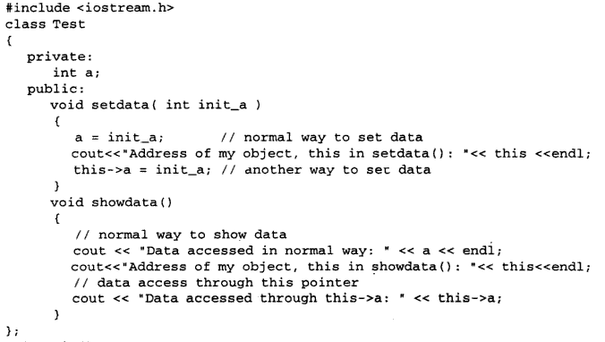
this pointer

Slide 75
Program 1
#include<iostream>
using namespace std;
class complex{
int *real,*imag;
public:
complex(){
real=new int; imag=new int;
*real=0; *imag=0;
}
complex(int a, int b){
real=new int; imag=new int;
*real=a; *imag=b;
}
complex add(complex obj){
*real=*real+*obj.real;
*imag=*imag+*obj.imag;
return *this;
}
void show(){
cout<<*real<<" " <<*imag<<endl;
}
~complex(){cout<<"destructor"<<endl;delete real; delete imag;}
};

Slide 76
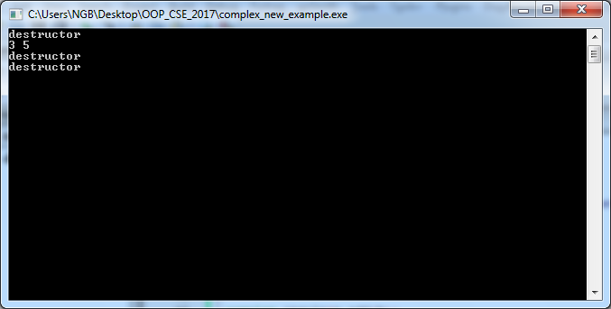
Output
int main(){
complex a(1,2);
complex b(2,3);
complex result=a.add(b);
result.show();
return 0;
}

